Slide 1
FINANCIAL PLANNING for DOCTORS
- Krishna Mohta & Rupali Singhania

Slide 2
Rules of Investments
Return of Capital
Liquidity
Return on Capital

Slide 3
INVESTMENT OPTIONS
WEALTH DESTROYERS
WEALTH PRESERVERS
WEALTH CREATORS
Fixed Deposits
LIC Traditional Plans
Endowment/Money Back Policies
Post Office Savings Deposit
PPF
Debt Mutual Funds
Gold/Silver
Equity Mutual Funds
Shares
ULIP
Real Estate

Slide 4
INVESTMENT PROCESS
ASSET ALLOCATION
FINANCIAL GOALS
DURATION
RISK APPETITE

Slide 5
FINANCIAL GOALS
Term | Time | Investment Products
Short Term Goals | < 4 years | Debt mutual funds, Fixed Deposits
Medium Term Goals | 4 to 7 years | Balanced Funds, Asset allocation funds
Long Term Goals | > 7 years | Equity mutual funds, Shares, Real Estate,
Short Term
Medium Term
Long Term
Setting up clinic / hospital
Getting married
Foreign vacation
Buy car
Buy home
Children’s education
Children’s marriage
Retirement

Slide 6
DURATION BASED INVESTMENTS
Duration | Fund Category
1 - 3 Months | Savings Account/Liquid Funds
3 Months - 1 Year | Fixed Deposit/ Ultra Short Term Debt Funds
1 - 4 Years | Fixed Deposit/ Short Term Debt Funds
4 - 7 Years | Balanced Funds/Asset Allocation Funds
> 7 Years | Equity Funds

Slide 7
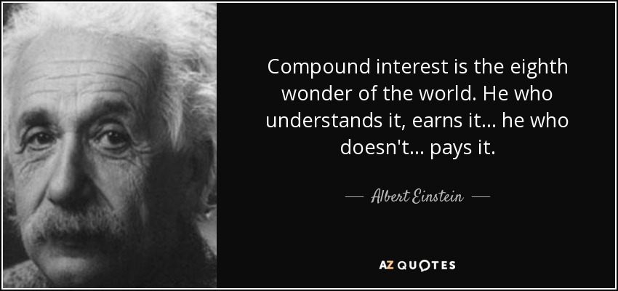

Slide 8
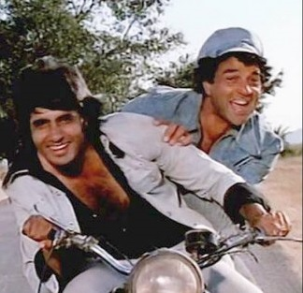
POWER of COMPOUNDING
Jai and Veeru are doctors both in 30 years of age.
 | Dr. Jai | Dr. Veeru
 | 30 years | 40 years
 | ₹ 25,000 | ₹ 25,000
 | 40 years | 65 years
 | 10 years | 25 years
 | ₹ 30 lacs | ₹ 75 lacs
Age at start of SIP
SIP amount
Invests till age
Total duration of SIP
Total Amount Invested

Slide 9
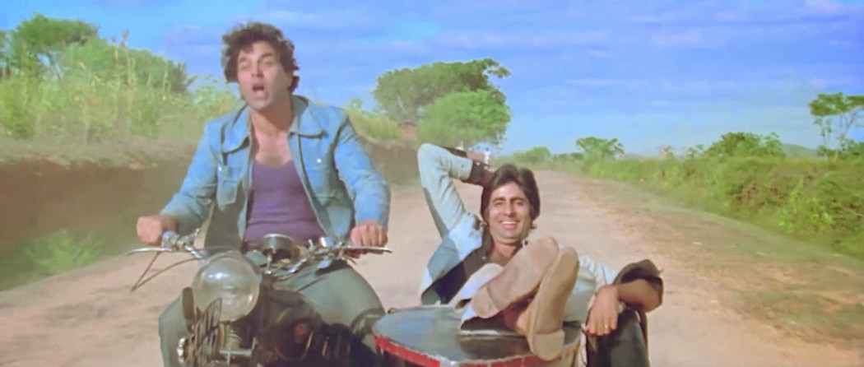
WHO DO YOU THINK WILL HAVE A BIGGER PORTFOLIO AT THE RETIREMENT AGE OF 65 YEARS?
It is important to plan and start investment for your retirement the day you start earning

Slide 10
Age (Years) | 30 | 35 | 40 | 45
SIP amount (Monthly) | ₹ 31,100 | ₹ 57,225 | ₹ 1,06,448 | ₹ 2,02,172
25
₹ 17,000

Slide 11
INVESTMENTS MISTAKES / MYTHS
Too many funds. Diversification or DiWORSIfication???
Funds with the same mutual fund category / Same mutual fund company
Not knowing scheme name/category
Chasing the best mutual fund
Churning in the name of rebalancing

Slide 12
IDEAL ASSET ALLOCATION
1 Large Cap (40%)
1 Mid Cap ( 20%)
1 Small Cap ( 20%)
1 Multi Cap (10%)
1 Sector Fund ( 10%)

Slide 13
SMART INVESTING
PPF (Yearly) | ₹ 1,50,000
Duration | 30 years
Total amount invested | ₹ 45,00,000
17 lacs surplus accumulated

Slide 14
Existing Investments vs Fresh Investments
Particulars | Value
SIP | ₹ 30,000
Duration | 20 years
Return | 12%
Corpus Accumulated | 3 Crores
Fresh Investments (Annual) | 3.60 Lacs
% of Portfolio | 1.2%

Slide 15
RISK PROTECTION
Life Insurance
Medical Insurance
Emergency Fund

Slide 16
TERM PLAN VS TRADITIONAL PLANS
Particulars | Term Plan | LIC Jeevan Anand
Cover | 1 Crore | 1 Crore
Premium | 34,000 | 3,71,000
Surplus (Yearly) | 3,37,000 | NA
Total Premium (For 30 years) | 8,58,000 | 1,11,30,000
Corpus | ₹ 8,13,29,115 | ₹ 3,57,00,000

Slide 18
Financial Planning and Products
Financial Planning Checklists:
Life Insurance
Health Insurance
Emergency Fund
Mutual Funds SIP / Lumpsum
Important Tips:
Never Ignore Inflation
Do not underestimate the power of COMPOUNDING
Financial Planning
Risk Protection
Investment

Slide 19
KEY TAKEAWAYS
Do not mix Insurance with Investments
Use short term money for short term goals, long term money for long term goals
As you near a goal, shift money from equity to debt to reduce risk
Monitor your portfolio regularly

Slide 20
Q&A

Slide 21
THANK YOU

